Slide 1
Doubly Linked Lists
CS 242

Slide 2
Singly linked list
We can efficiently (O(1)) do the following
  insert a node at either end of a singly linked list
  delete a node at the head of a list
We are unable to efficiently delete a node at the tail of the list. Why??
Given a reference to a node at any position, we can not delete it in efficient time.

Slide 3
Doubly Linked Lists
A linked list in which each node keeps an explicit reference to the node before it and a reference to the node after it
O(1)-time update operations
In defining the Node class
  “next” for the reference to the node that follows it
  “prev” for the reference to the node that precedes it

Slide 4
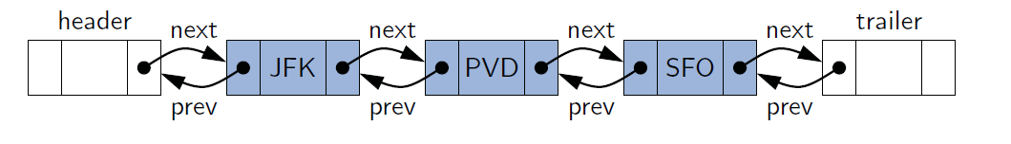
Header and trailer
Special nodes at both ends of the list.
Make implementation easier
  Every insertion/deletion is between a pair of existing nodes.
Can be implemented without them
  Save space
  Need to consider special cases at the beginning and at the end

Slide 5
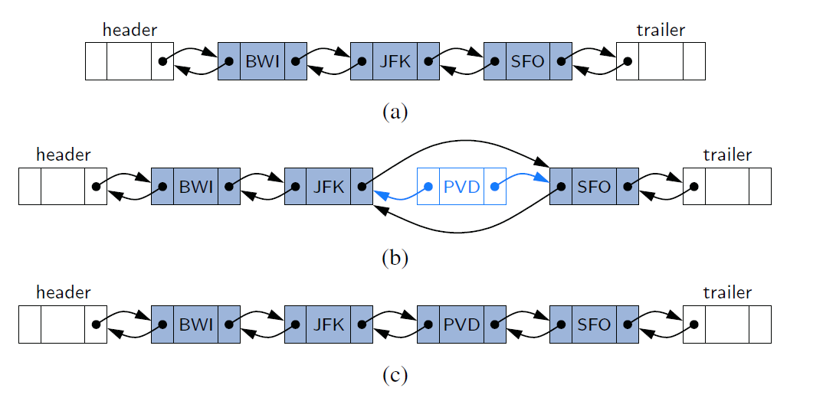
Inserting with a Doubly Linked List

Slide 6
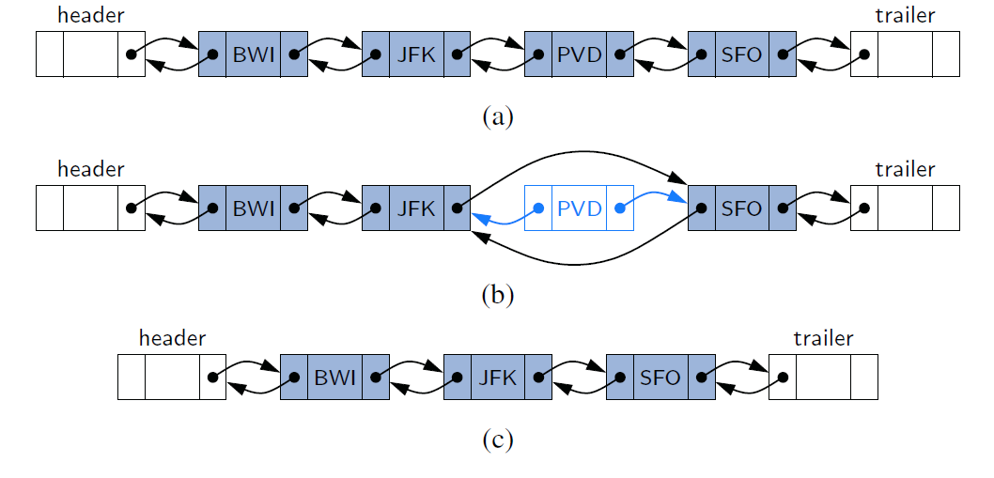
Deleting with a Doubly Linked List

Slide 7
Implementing a Doubly Linked List Class
size( ): Returns the number of elements in the list.
isEmpty( ): Returns true if the list is empty, and false otherwise.
first( ): Returns (but does not remove) the first element in the list.
last( ): Returns (but does not remove) the last element in the list.
addFirst(e): Adds a new element to the front of the list.
addLast(e): Adds a new element to the end of the list.
removeFirst( ): Removes and returns the first element of the list.
removeLast( ): Removes and returns the last element of the list.

Slide 8
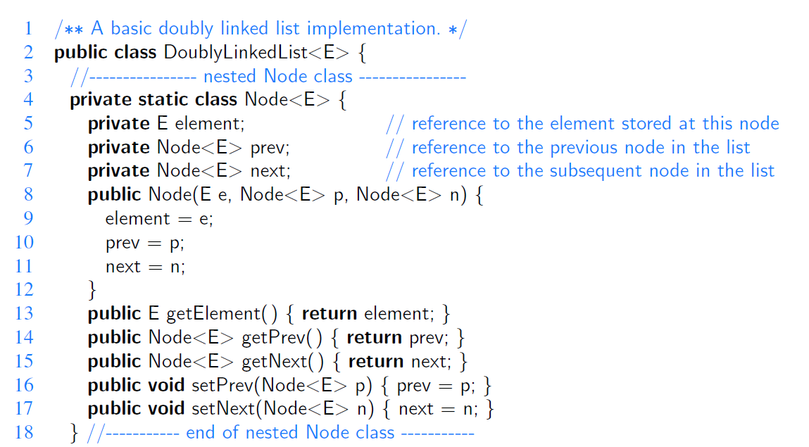
Private Class Node
element
X
prev
next

Slide 9
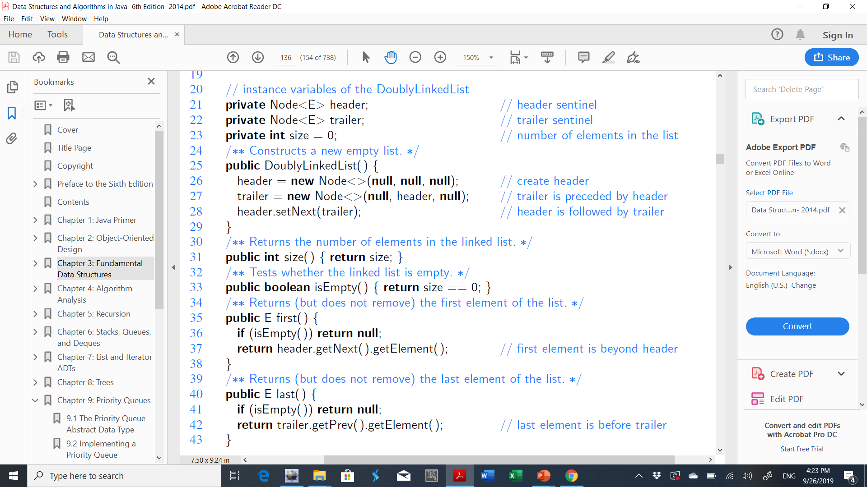
The Attributes and the Constructor
header
trailer

Slide 10
Access Methods

Slide 11
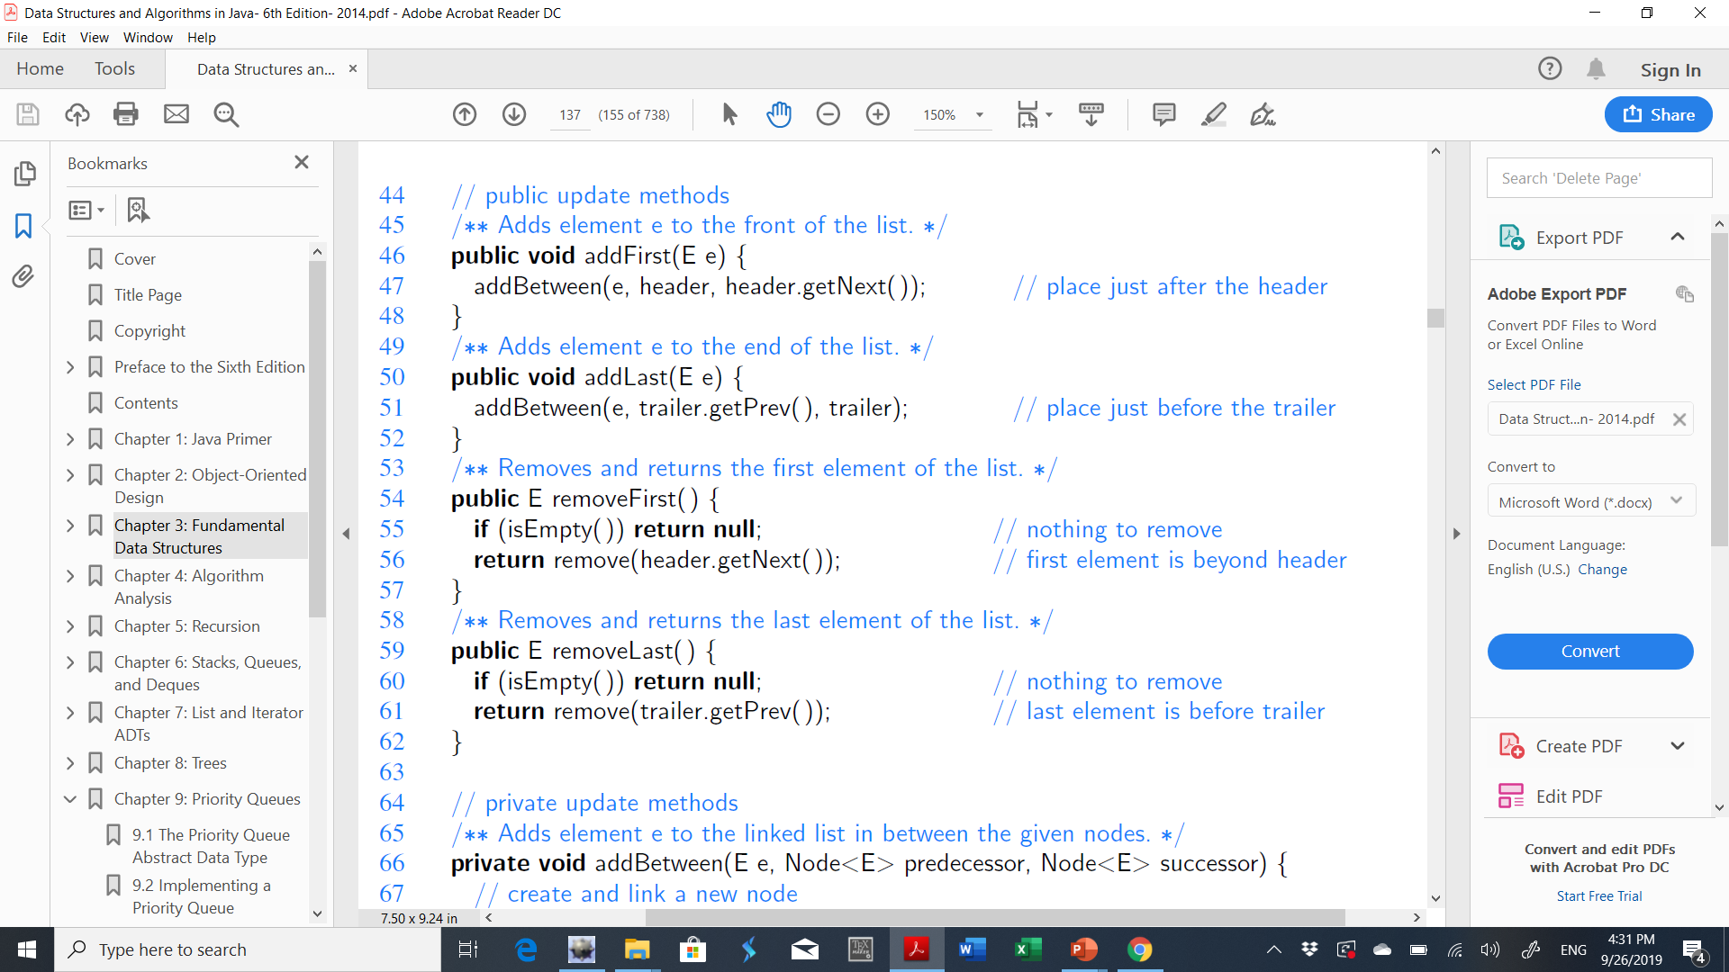
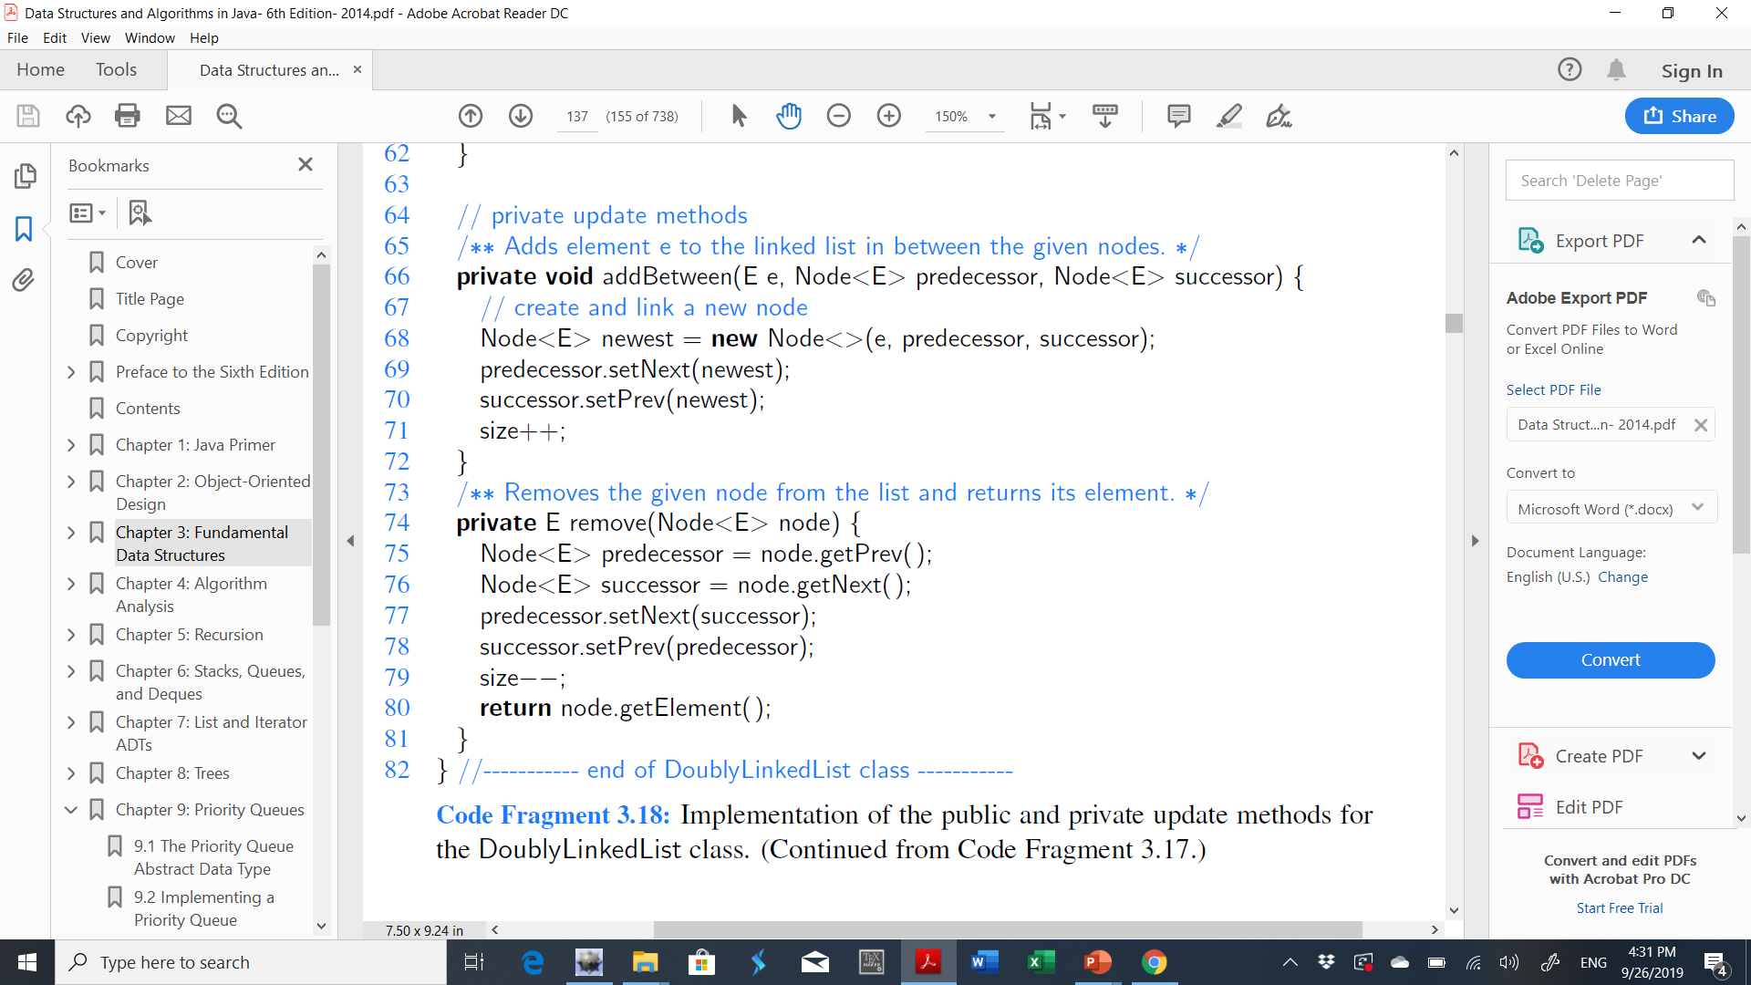
Public update methods

Slide 12
Inserting with a Doubly Linked List

Slide 13
Public update methods

Slide 14
Deleting with a Doubly Linked List

Slide 15
Exercise
Describe in pseudo-code how to swap two nodes x and y in a singly linked list L given references only to x and y. Repeat this exercise for the case when L is a doubly linked list. What are the running times of each of these methods in terms of n, the number of nodes in L?

